Slide 1
Server Side Event And WebHook, how, between and when
Joshua Lartey

Slide 2
Definitions
A webhook is a way for applications or services to communicate with each other in a real-time manner. It allows one application to send data to another application whenever a specific event or trigger occurs
Server-Sent Events (SSE) is a technology that enables the server to send real-time updates to the client over a single HTTP connection.

Slide 3
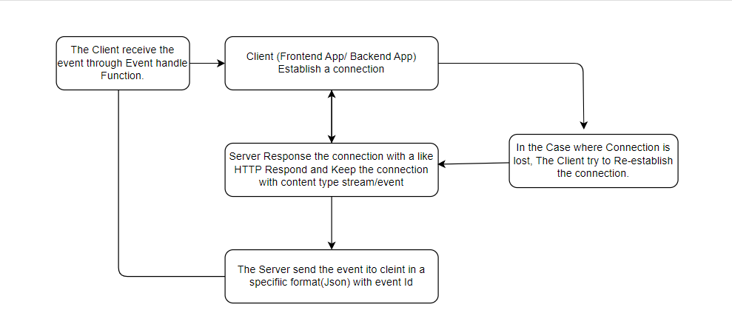
How Server Side Event Work

Slide 4
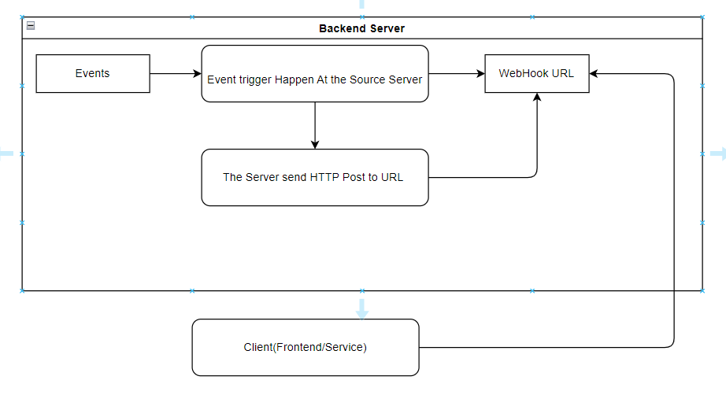
How WebHooks Works

Slide 5
Similarities Between Server Side Event and WebHooks
Real-time communication
Event-driven architecture
Asynchronous communication
HTTP-based communication

Slide 6
Differences Between Server Side Event and WebHooks
Direction of communication
Connection persistence
Data format and delivery
Error handling and retries

Slide 7
Conclusion
Overall, SSE and webhooks are both effective in enabling real-time communication and event-driven workflows. SSE is particularly suitable for scenarios where the server needs to push data updates to the client continuously. Webhooks, on the other hand, are commonly used for notifying and triggering actions in recipient applications when specific events occur in the source application.

Slide 8
Questions?

